Slide 1
IMAGE STEGANOGRAPHY
CAPSTONE PROJECT
Presented By:
Student Name : J.S.T Vamsi Krishna
College Name & Department : Sri Vasavi Engineering
College AIM Department

Slide 2
OUTLINE
Problem Statement
Technology used
Wow factor
End users
Result
Conclusion
Git-hub Link
Future scope

Slide 3
Problem Statement
Image steganography is used to hide a password and associated data within an image file by modifying the least significant bits (LSB) of the pixel values. The code enables embedding the password and data into the image and extracting them later. The password acts as a key to ensure only authorized users can access the data. The solution is hidden data, which includes both the password and the associated data.

Slide 4
Technology used
System Requirements:
Operating System :
- Windows, macOS, or Linux (any platform that supports Python and the required libraries).
Python :
- Python 3.6 or higher is recommended for compatibility with the libraries used in the code.
Libraries :
- Pillow (PIL) : For image manipulation.
- Installation: pip install Pillow
Hardware :
- Processor : Intel Core i3
- RAM : Minimum (4GB recommended 8 GB)
Software :
- Text editor or IDE (e.g., VS Code, PyCharm) for writing and running the Python code.

Slide 5
Wow factors
Utilizes LSB steganography to securely hide both password and data within an image.
Implements password protection to ensure only authorized users can retrieve the hidden data.
Encodes the lengths of both the password and data for efficient and accurate extraction.
Ensures minimal image distortion while hiding data, maintaining high image quality.
Cross-platform compatibility, allowing the project to run on Windows, macOS, and Linux.

Slide 6
End users
1. Privacy-Conscious Individuals : People who want to securely hide and share sensitive information (e.g., passwords, personal data) without exposing it.
2. Cybersecurity Professionals : Experts in the field of digital security who need a secure method to store or transfer sensitive data.
3. Researchers : Individuals in fields such as cryptography, data security, or digital forensics who are interested in steganography for secure communication or data analysis.
4. Developers : Software developers or programmers looking for a secure method to embed and retrieve hidden data in images for applications or projects.
5. Government Agencies and Military : Organizations, including the army, requiring secure communication methods to transmit sensitive data covertly without detection or tampering.

Slide 7
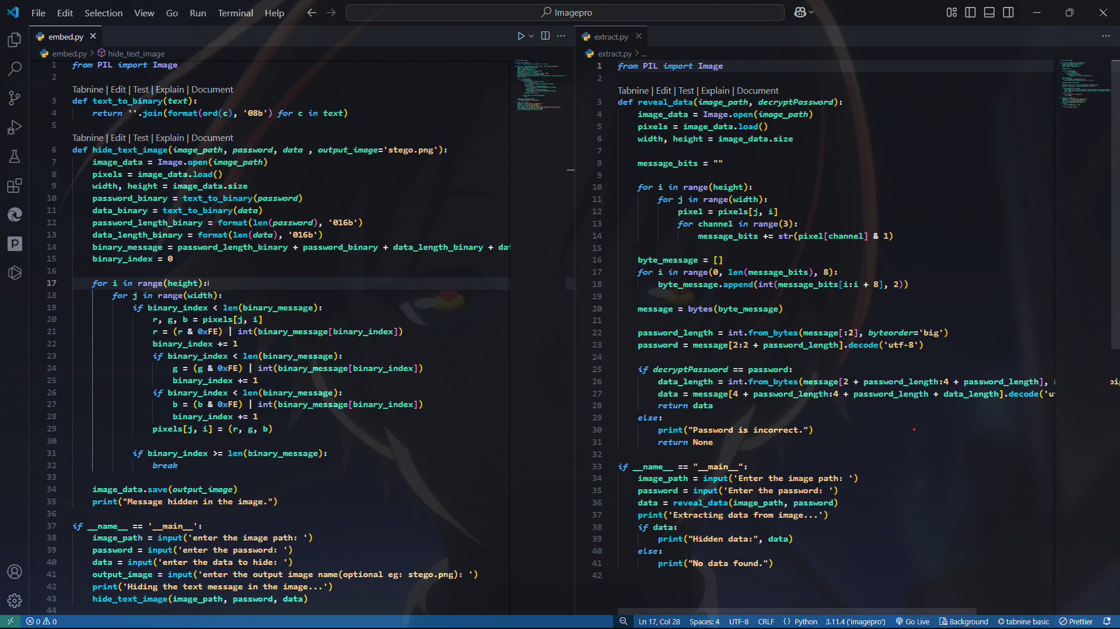
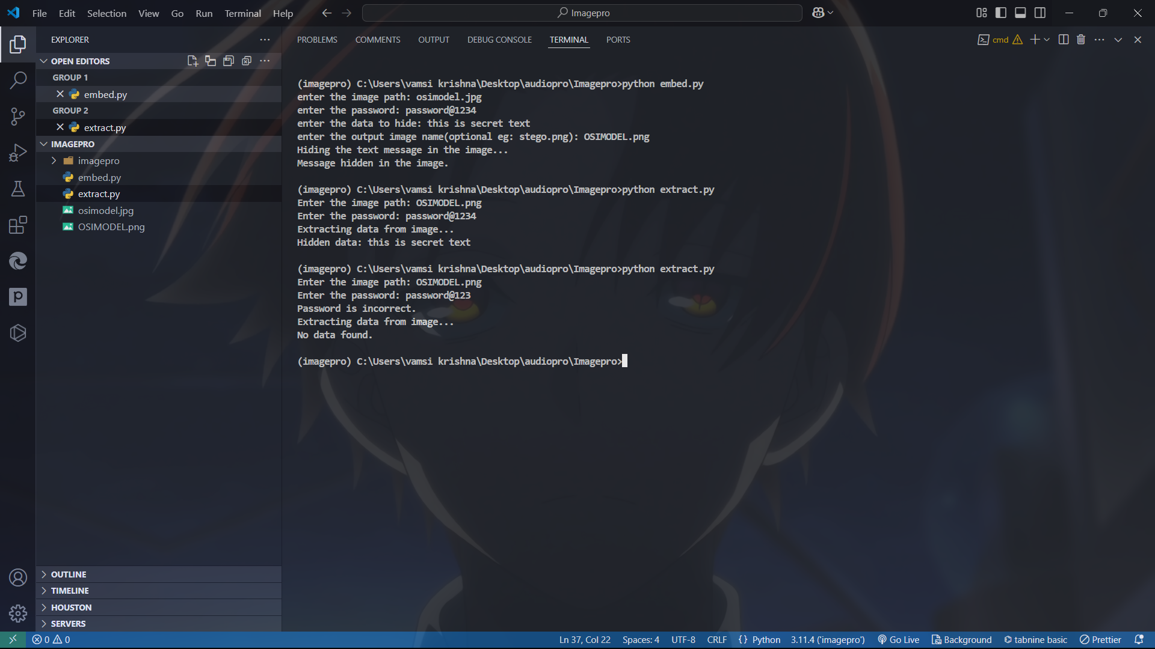
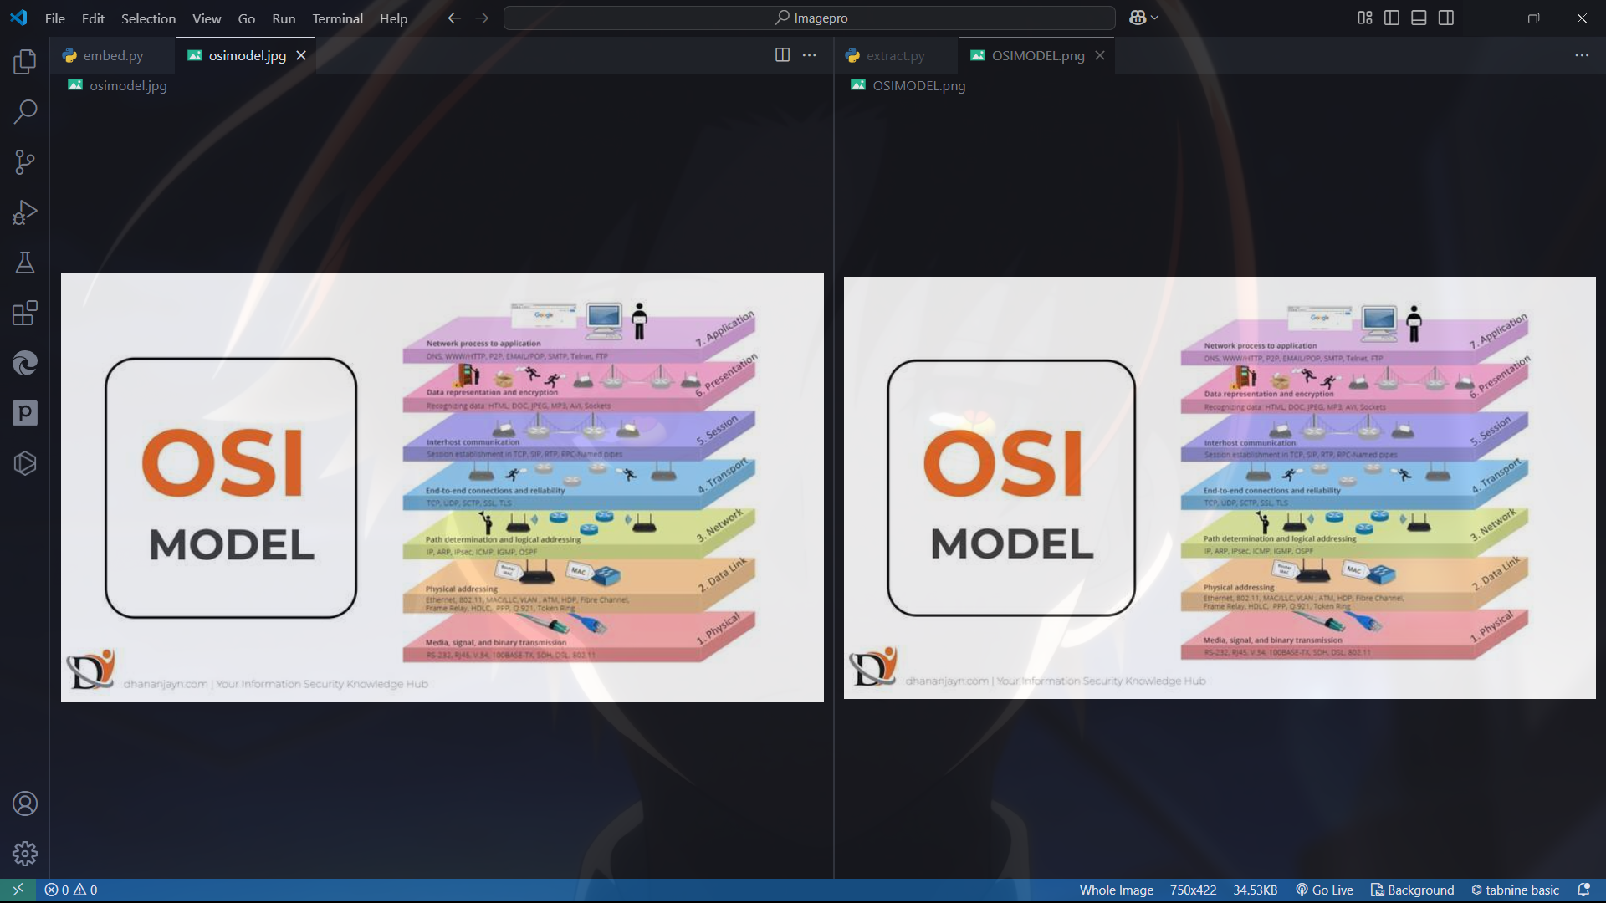
Results
SOURCE CODE
OUTPUT
RESULT IMAGES

Slide 8
Conclusion
In conclusion, this project demonstrates a practical and secure approach to image steganography by effectively hiding both passwords and associated data within an image using LSB (Least Significant Bit) manipulation. With password protection, it ensures that only authorized users can access the hidden information. This solution offers a reliable and efficient method for safeguarding sensitive data, making it suitable for privacy-conscious individuals, cybersecurity professionals, researchers, developers, and government or military organizations in need of secure communication channels.

Slide 9
GitHub Link
https://github.com/SreeTarak2/ImageSteganography.git

Slide 10
Future scope(optional)

Slide 11
THANK YOU

